Slide 1
STOR 455 Additional Topics in ANOVA
Read: 8.1, 8.2
Exercises: 8.3, 8.6

Slide 2
Final Exam
30% of Course Grade
Cumulative and covers the entire semester
Answer MC questions in class through Gradescope
Class on Thursday as a review class.

Slide 3
Summary of Extra Credit Opportunities
Picking my math mistakes (not English typos or grammar mistakes) on slides and the blackboard. 0.5% each.
Finishing the course evaluation and forwarding me the confirmation. 1%.
Individual project on wrong linear models by April 29th. 1%.
Group project on movie box office prediction by April 19th.
Prediction competition: up to 1%.
Data collection and Analysis: 1%.
Will grade the analysis and post the spreadsheet of predictions this weekend.
Extra credit homework: 2%. Due April 30th.

Slide 4
Cancer Survival with Ascorbate Supplement
In the 1970’s doctors wondered if giving terminal cancer patients a supplement of ascorbate would prolong their lives. They designed an experiment to compare cancer patients who received ascorbate to cancer patients who did not receive the supplement. The result of that experiment was that, in fact, ascorbate did seem to prolong the lives of these patients. But then a second question arose. Was the effect of the ascorbate different when different organs were affected by the cancer? The researchers took a second look at the data. This time they concentrated only on those patients who received the ascorbate and divided the data up by which organ was affected by the cancer. They had 5 different organs represented among the patients (all of whom only had one organ affected): Stomach, bronchus, colon, ovary, and breast.
CancerSurvival in Stat2Data package

Slide 5
Cancer Survival with Ascorbate Supplement
library(Stat2Data)
data("CancerSurvival")
head(CancerSurvival)
Cancermod = aov(Survival~Organ, data=CancerSurvival)
summary(Cancermod)
Df Sum Sq Mean Sq F value Pr(>F)
Organ 4 11535761 2883940 6.433 0.000229 ***
Residuals 59 26448144 448274
Test: H_{o}: μ₁ = μ₂=...= μ_{K}
H_{a}: Some μ_{i} ≠μ_{j}
Reject H₀

Slide 6
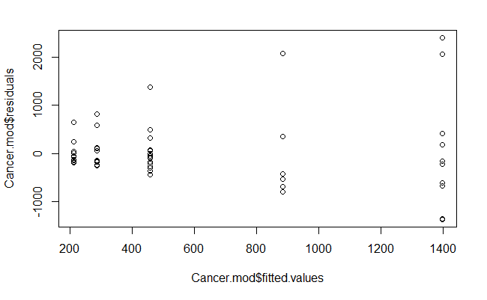
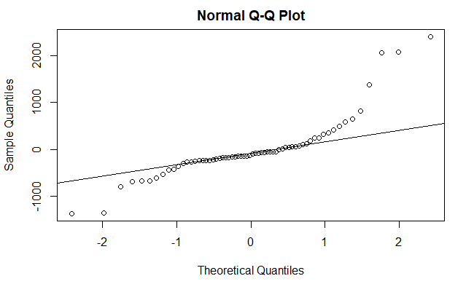
Cancer Survival with Ascorbate Supplement
plot(Cancermod$residuals~Cancermod$fitted.values)
qqnorm(Cancermod$residuals)
qqline(Cancermod$residuals)

Slide 7
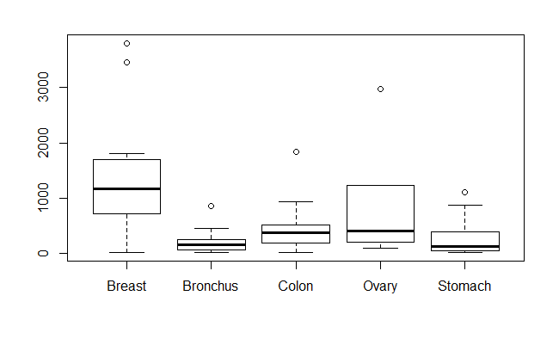
Cancer Survival with Ascorbate Supplement
boxplot(Survival~Organ, data=CancerSurvival)
tapply(CancerSurvival$Survival,CancerSurvival$Organ, sd)
Breast Bronchus Colon Ovary Stomach
1238.9667 209.8586 427.1686 1098.5788 346.3096

Slide 8
Cancer Survival with Ascorbate Supplement
leveneTest(CancerSurvival$Survival,CancerSurvival$Organ)
Levene's Test for Homogeneity of Variance (center = median)
Df F value Pr(>F)
group 4 4.4524 0.003271 **
59
Reject H₀
Would a transformation help?

Slide 9
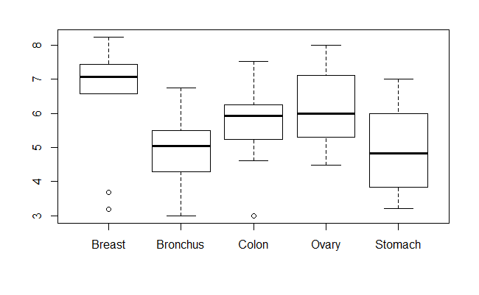
Cancer Survival with Ascorbate Supplement
boxplot(log(Survival)~Organ, data=CancerSurvival)
tapply(log(CancerSurvival$Survival),CancerSurvival$Organ, sd)
Breast Bronchus Colon Ovary Stomach
1.6477550 0.9534041 0.9974766 1.2569313 1.2502073

Slide 10
Cancer Survival with Ascorbate Supplement
leveneTest(log(CancerSurvival$Survival),CancerSurvival$Organ)
Levene's Test for Homogeneity of Variance (center = median)
Df F value Pr(>F)
group 4 0.6685 0.6164
59
Fail to Reject H₀

Slide 11
Cancer Survival with Ascorbate Supplement
Cancermod_log = aov(log(Survival)~Organ, data=CancerSurvival)
summary(Cancermod_log)
Df Sum Sq Mean Sq F value Pr(>F)
Organ 4 24.49 6.122 4.286 0.00412 **
Residuals 59 84.27 1.428
Test: H_{o}: μ₁ = μ₂=...= μ_{K}
H_{a}: Some μ_{i} ≠μ_{j}
Reject H₀

Slide 12
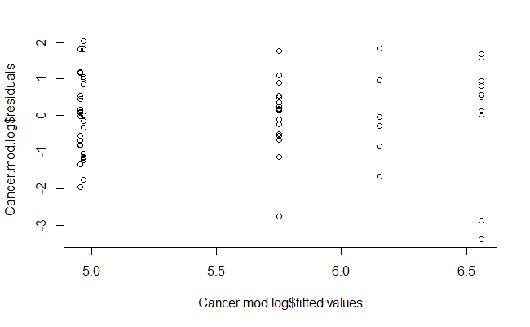
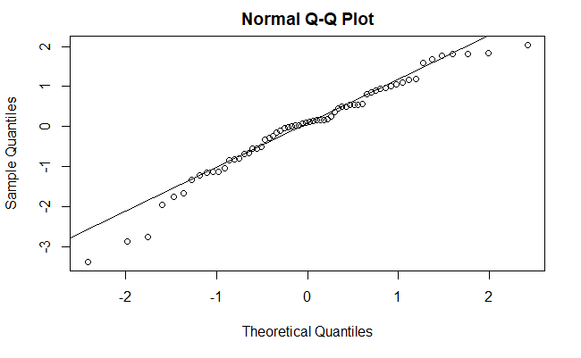
Cancer Survival with Ascorbate Supplement
plot(Cancermod_log$residuals~Cancermod_log$fitted.values)
qqnorm(Cancermod_log$residuals)
qqline(Cancermod_log$residuals)

Slide 13
Cancer Survival with Ascorbate Supplement
TukeyHSD(Cancermod_log)
Tukey multiple comparisons of means
95% family-wise confidence level
Fit: aov(formula = log(Survival) ~ Organ, data = CancerSurvival)
$`Organ`
diff lwr upr p adj
Bronchus-Breast -1.60543320 -2.906741 -0.3041254 0.0083352
Colon-Breast -0.80948110 -2.110789 0.4918267 0.4119156
Ovary-Breast -0.40798703 -2.114754 1.2987803 0.9615409
Stomach-Breast -1.59068365 -2.968399 -0.2129685 0.0158132
Colon-Bronchus 0.79595210 -0.357534 1.9494382 0.3072938
Ovary-Bronchus 1.19744617 -0.399483 2.7943753 0.2296079
Stomach-Bronchus 0.01474955 -1.224293 1.2537924 0.9999997
Ovary-Colon 0.40149407 -1.195435 1.9984232 0.9540004
Stomach-Colon -0.78120255 -2.020245 0.4578403 0.3981146
Stomach-Ovary -1.18269662 -2.842480 0.4770864 0.2763506

Slide 14
Fruit Flies
Hanley and Shapiro (1994) report on a study conducted by Partridge and Farquhar (1981) about the sexual behavior of fruit flies. It was already known that increased reproduction leads to shorter life spans for female fruit flies. But the question remained whether an increase in sexual activity would also reduce the life spans of male fruit flies. The researchers designed an experiment to answer this question. They had a total of 125 male fruit flies to use and they randomly assigned each of the 125 to one of the five treatment groups.
ID a numeric vector Partners Number of female partners: 0, 1, or 8
Type 0=pregnant, 1=virgin, 9=none Longevity Lifespan (in days)
Thorax Length of thorax (in mm) Sleep Percent of day sleeping
Treatment 1 pregnant, 1 virgin, 8 pregnant, 8 virgin, or none
FruitFlies in Stat2Data package

Slide 15
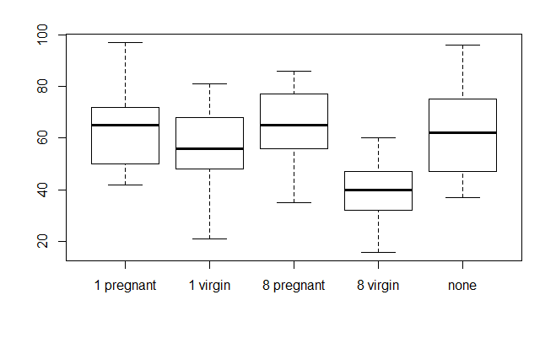
Fruit Flies
boxplot(Longevity~Treatment, data=FruitFlies)
tapply(FruitFlies$Longevity,FruitFlies$Treatment, mean)
tapply(FruitFlies$Longevity,FruitFlies$Treatment, sd)
1 pregnant 1 virgin 8 pregnant 8 virgin none
64.80 56.76 63.36 38.72 63.56
1 pregnant 1 virgin 8 pregnant 8 virgin none
15.65248 14.92838 14.53983 12.10207 16.45215

Slide 16
Fruit Flies
Fly.mod = aov(Longevity~Treatment, data=FruitFlies)
summary(Fly.mod)
Df Sum Sq Mean Sq F value Pr(>F)
Treatment 4 11939 2984.8 13.61 3.52e-09 ***
Residuals 120 26314 219.3
Test: H_{o}: μ₁ = μ₂=...= μ_{K}
H_{a}: Some μ_{i} ≠μ_{j}
Reject H₀

Slide 17
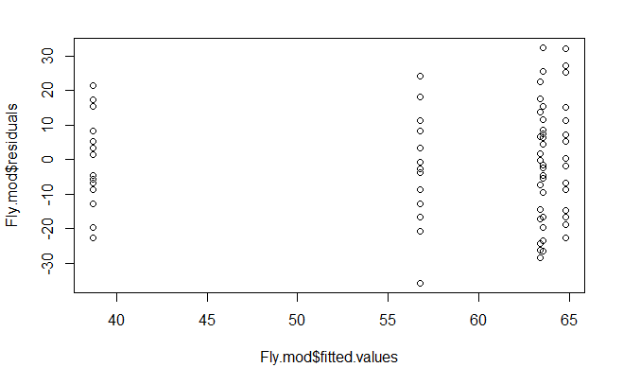
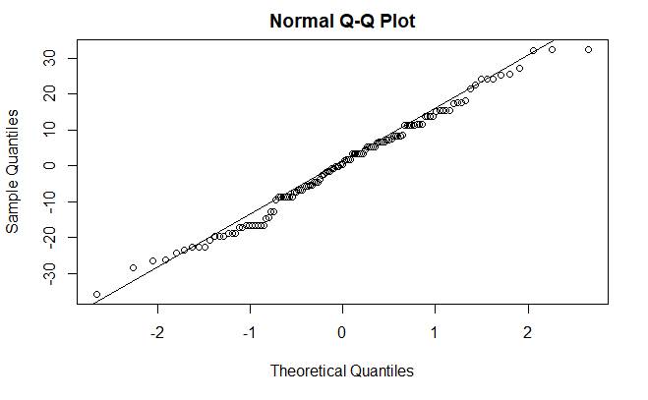
Fruit Flies
plot(Fly.mod$residuals~Fly.mod$fitted.values)
qqnorm(Fly.mod$residuals)
qqline(Fly.mod$residuals)

Slide 18
Fruit Flies
leveneTest(Longevity~Treatment, data=FruitFlies)
Levene's Test for Homogeneity of Variance (center = median)
Df F value Pr(>F)
group 4 0.4916 0.7419
120
Fail to Reject H₀

Slide 19
Fruit Flies Comparisons
A comparison looks at just two of the K possible groups in a study.
TukeyHSD(Fly.mod)
Tukey multiple comparisons of means
95% family-wise confidence level
Fit: aov(formula = Longevity ~ Treatment, data = FruitFlies)
$`Treatment`
diff lwr upr p adj
1 virgin-1 pregnant -8.04 -19.640468 3.560468 0.3126549
8 pregnant-1 pregnant -1.44 -13.040468 10.160468 0.9969591
8 virgin-1 pregnant -26.08 -37.680468 -14.479532 0.0000001
none-1 pregnant -1.24 -12.840468 10.360468 0.9983034
8 pregnant-1 virgin 6.60 -5.000468 18.200468 0.5157692
8 virgin-1 virgin -18.04 -29.640468 -6.439532 0.0003240
none-1 virgin 6.80 -4.800468 18.400468 0.4854206
8 virgin-8 pregnant -24.64 -36.240468 -13.039532 0.0000004
none-8 pregnant 0.20 -11.400468 11.800468 0.9999988
none-8 virgin 24.84 13.239532 36.440468 0.0000003

Slide 20
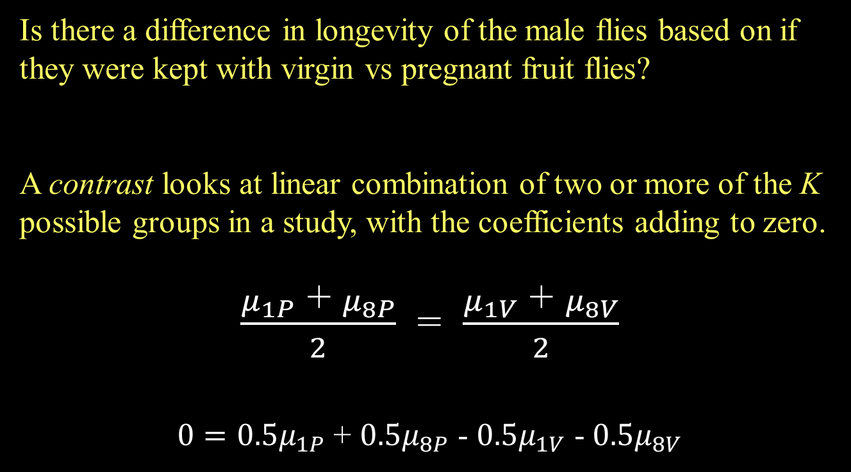
Fruit Flies Contrast
Is there a difference in longevity of the male flies based on if they were kept with virgin vs pregnant fruit flies?
A contrast looks at linear combination of two or more of the K possible groups in a study, with the coefficients adding to zero.
$\frac{μ_{1P}\text{ + }μ_{8P}}{2}$ = $\frac{μ_{1V}\text{ + }μ_{8V}}{2}$
$0=0.5μ_{1P}$ + $0.5μ_{8P}$ - $0.5μ_{1V}$ - $0.5μ_{8V}$
Note: A comparison is a special case of a contrast.

Slide 21
The standard error of a contrast is given by:
Contrast
Std. error

Slide 22
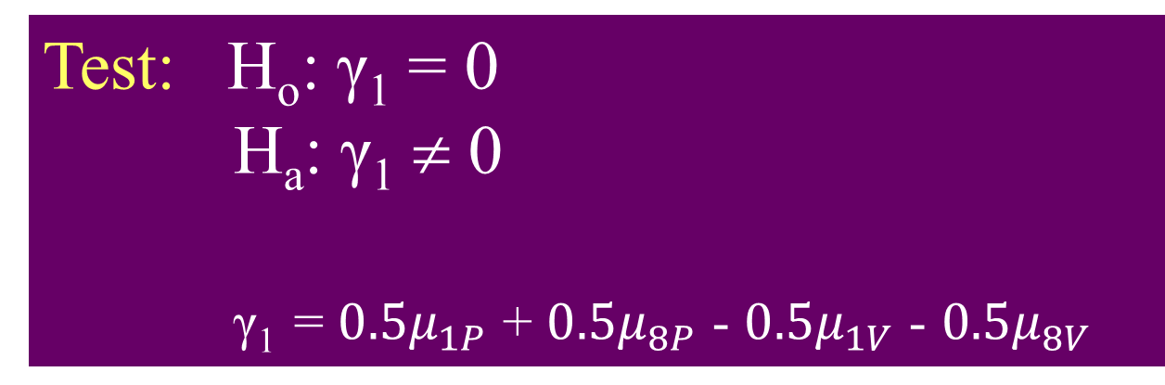
Fruit Fly Contrast
Test: H_{o}: γ₁ = 0
H_{a}: γ₁ ≠ 0
γ₁ = $0.5μ_{1P}$ + $0.5μ_{8P}$ - $0.5μ_{1V}$ - $0.5μ_{8V}$
summary(Fly.mod)
Df Sum Sq Mean Sq F value Pr(>F)
Treatment 4 11939 2984.8 13.61 3.52e-09 ***
Residuals 120 26314 219.3
Fly.MSE = summary(Fly.mod)[[1]][2,3]

Slide 23
Fruit Fly Contrast
Contrast.SE = sqrt(Fly.MSE*((.5)^2/25+(-.5)^2/25+(.5)^2/25+(-.5)^2/25))
contrast = -0.5*mean(FruitFlies$Longevity[FruitFlies$Treatment=="1 virgin"])
-0.5*mean(FruitFlies$Longevity[FruitFlies$Treatment=="8 virgin"]) +0.5*mean(FruitFlies$Longevity[FruitFlies$Treatment=="1 pregnant"]) +0.5*mean(FruitFlies$Longevity[FruitFlies$Treatment=="8 pregnant"])

Slide 24
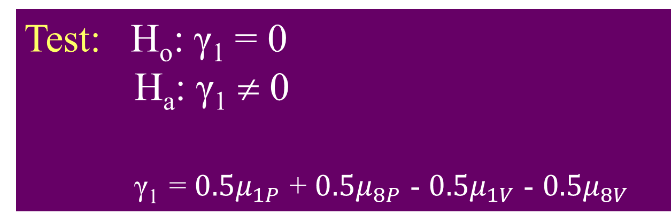
Fruit Fly Contrast
t.stat = contrast/Contrast.SE
2*(1-pt(t.stat, 120))
[1] 2.015553e-07
Test: H_{o}: γ₁ = 0
H_{a}: γ₁ ≠ 0
γ₁ = $0.5μ_{1P}$ + $0.5μ_{8P}$ - $0.5μ_{1V}$ - $0.5μ_{8V}$
Reject H₀

Slide 25
Fruit Fly Contrast
library(gmodels)
tapply(FruitFlies$Longevity, FruitFlies$ Treatment, mean)
1 pregnant 1 virgin 8 pregnant 8 virgin none
64.80 56.76 63.36 38.72 63.56
fit.contrast(Fly.mod, FruitFlies$ Treatment, c(0.5, -0.5, 0.5, -0.5, 0))
Estimate Std. Error t value Pr(>|t|)
Treatment c=( 0.5 -0.5 0.5 -0.5 0 ) 16.34 2.961617 5.517257 2.015553e-07
fit.contrast(Fly.mod, FruitFlies$ Treatment, c(0.5, -0.5, 0.5, -0.5, 0),
conf.int=0.95)
Estimate Std. Error t value Pr(>|t|)
Treatment c=( 0.5 -0.5 0.5 -0.5 0 ) 16.34 2.961617 5.517257 2.015553e-07
lower CI upper CI
Treatment c=( 0.5 -0.5 0.5 -0.5 0 ) 10.47621 22.20379

Slide 26
Fruit Flies Contrast
Is there a difference in longevity of the male flies based on if they were kept with female fruit flies or not?
Test: H_{o}: γ₂ = 0
H_{a}: γ₂ ≠ 0
γ₂ = ?
Determine the appropriate contrast and complete the hypothesis test.

